Slide 1
what is a .horse?

Slide 2

every.horse
A simple list of every .horse domain.

Slide 3
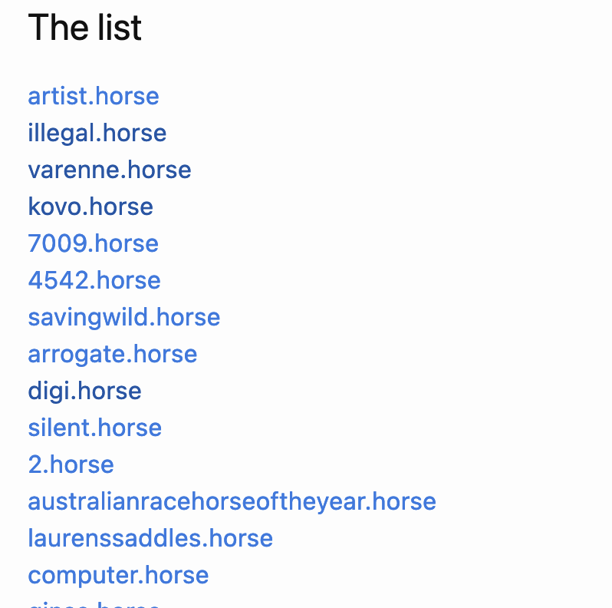

Slide 4

Is there an underlying essence of .horse-iness?

Slide 5
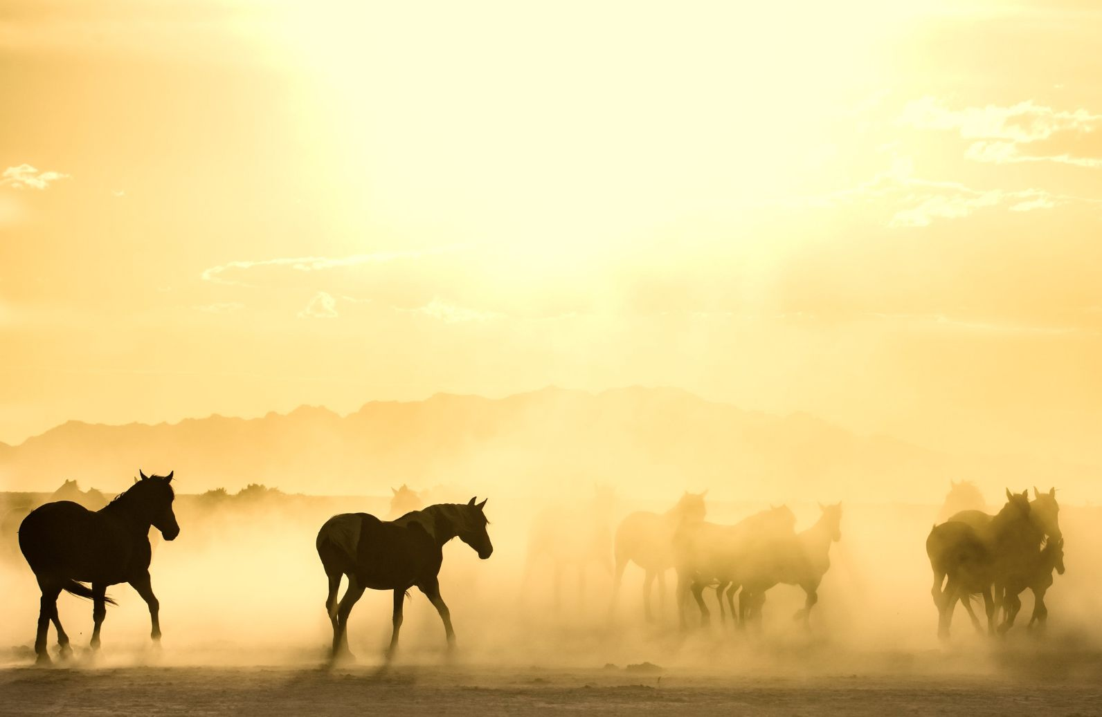
Could web archiving tools shed some light?

Slide 6
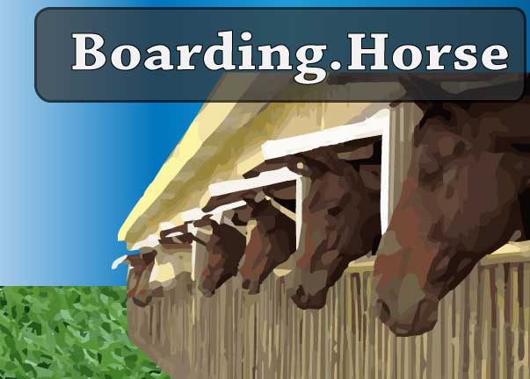
Have we .horse in our stable?

Slide 7
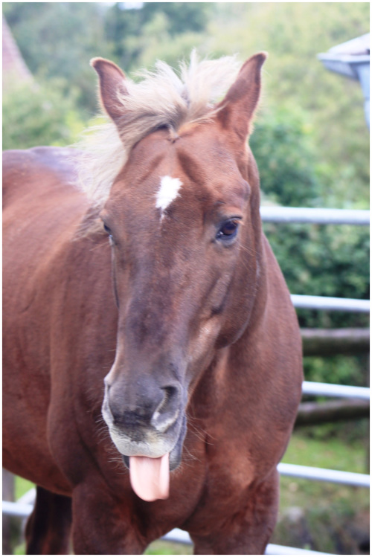

Slide 8


Slide 9
Three thousand four hundred ninety eight URLs
ArchiveIt

Slide 10
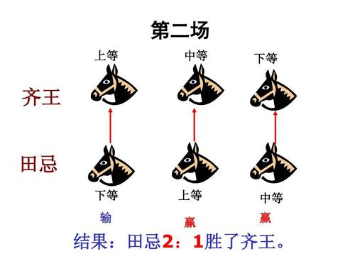
Will a .horse crawl?

Slide 11
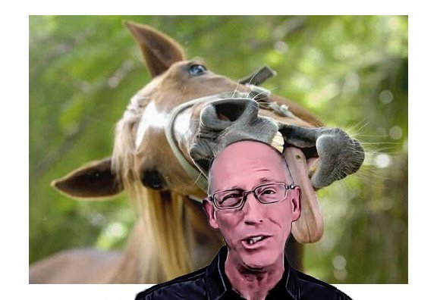

Slide 12

Many .horse are shy
Blocked by robots.txt

Slide 13
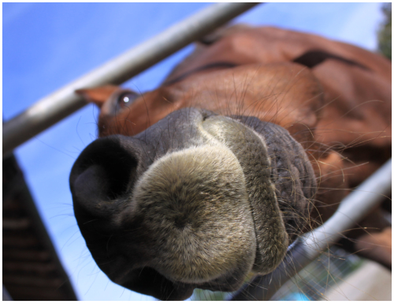
Many .horse are poorly trained
4XX and 5XX response codes

Slide 14
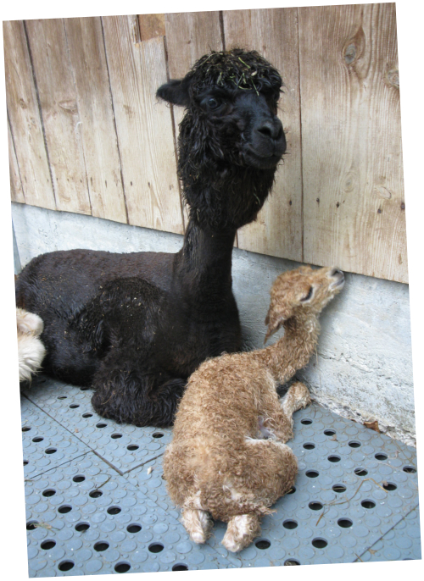
Many weren’t actually .horse at all
Redirecting to non .horse domains

Slide 15

Two thousand one hundred seventy seven

Slide 16
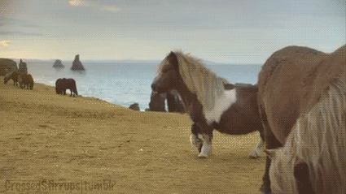

Slide 17

OK…but now what?

Slide 18
ARCH:
Archives Research Compute Hub
Builds on lots of great work from the Archives Unleashed folks, but run on Internet Archive infrastructure
Still in closed beta

Slide 19
Extract Named Entities Extract Images with Alt text
Extract Full text
Not just a three trick pony

Slide 20
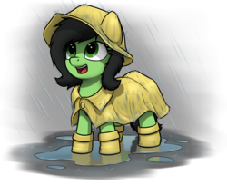

Slide 21


Slide 22
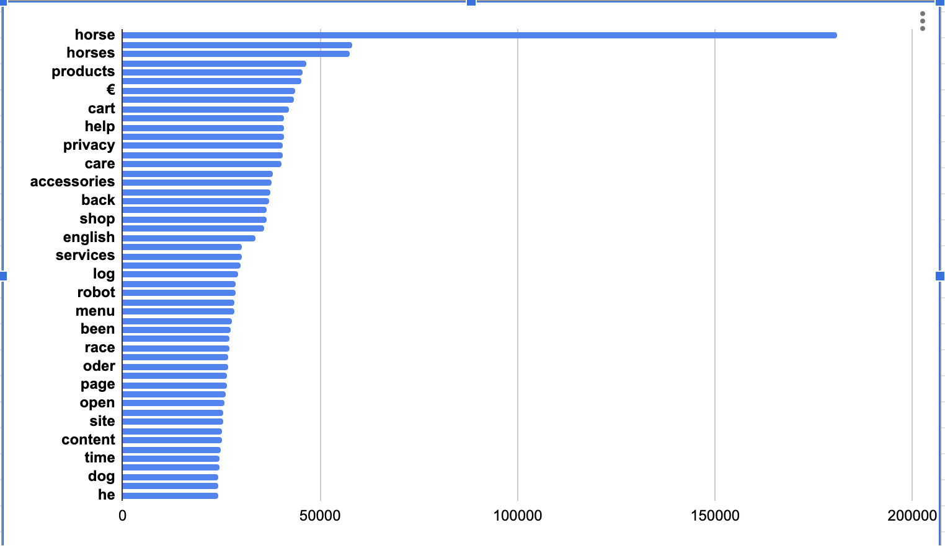

Slide 23
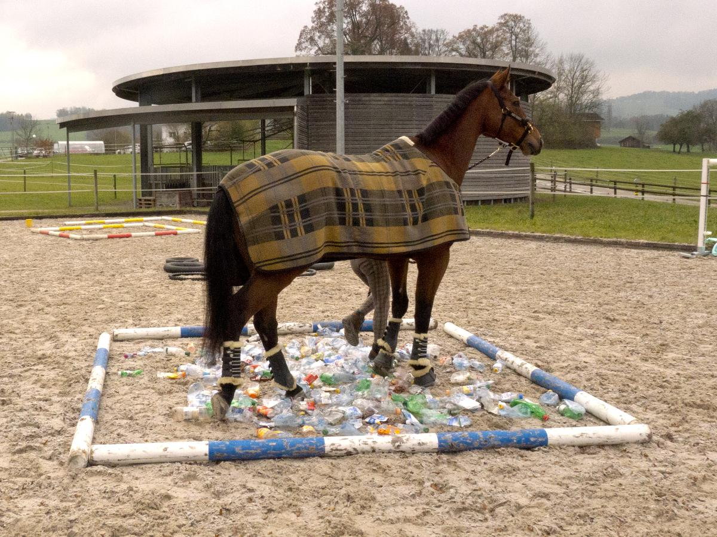

Slide 24
Did I discover the truth of .horse?
Perhaps the wild .horse data just could not be tamed.

Slide 25


